Slide 1

Variational Inference for Dirichlet Process Mixture
Applied Bayesian Nonparametrics
Special Topics in Machine Learning
Brown University CSCI 2950-P, Fall 2011
Daniel Klein and Soravit Beer Changpinyo
October 11, 2011

Slide 2
Motivation
WANTED! A systematic approach to sample from likelihoods and posterior distributions of the DP mixture models
Markov Chain Monte Carlo (MCMC)
Problems with MCMC
Can be slow to converge
Convergence can be difficult to diagnose
One alternative: Variational methods

Slide 3
Variational Methods: Big Picture
An adjustable lower bound on the log likelihood, indexed by
“Variational parameters”
Optimization problem:
to get the tightest lower bound
Notes:
(Blei et al., 2003)
The basic idea of convexity-based variational inference is to make use of Jensen’s inequality to obtain
an adjustable lower bound on the log likelihood (Jordan et al., 1999). Essentially, one considers
a family of lower bounds, indexed by a set of variational parameters. The variational parameters
are chosen by an optimization procedure that attempts to find the tightest possible lower bound.
A simple way to obtain a tractable family of lower bounds is to consider simple modifications
of the original graphical model in which some of the edges and nodes are removed.

Slide 4
Outline
Brief Review: Dirichlet Process Mixture Models
Variational Inference in Exponential Families
Variational Inference for DP mixtures
Gibbs sampling (MCMC)
Experiments

Slide 5
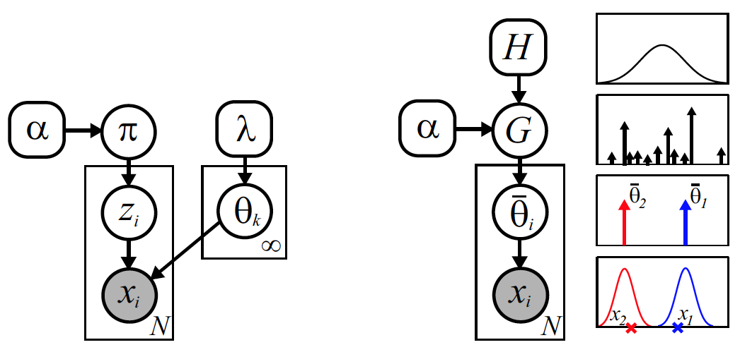

DP Mixture Models
From E.B. Sudderth’s slides
Notes:
We have seen these two representations of the DP mixture models. This paper focuses on the stick-breaking representation (left)

Slide 6
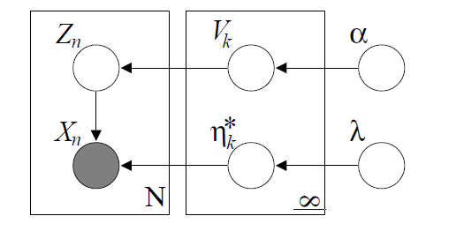
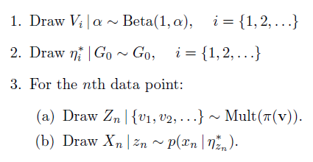
DP Mixture Models
Stick lengths =
weights assigned to
mixture components
Atoms representing
mixture components
(cluster parameters)
Notes:
This model is equivalent to the stick-breaking representation of the DP mixture

Slide 7
DP Mixture Models: Notations
Latent variables
Hyperparameters
Observations

Slide 8
DP Mixture Models: Notations
Latent variables
Hyperparameters
θ = {α, λ}
W = {V, η*, Z}
X
Observations

Slide 9

Variational Inference
Usually intractable
So, we are going to approximate it
by finding a lower bound of P(X|θ)
Notes:
We are interested in finding posterior distribution of latent variables given data and hyperparameters

Slide 10





Variational Inference
Jensen’s inequality
Variational distribution

Slide 11



Variational Inference
Add constraint to q by introducing
“the free variational parameters”
ν
:=
Notes:
As q(w) gets closer to the true posterior distribution p(w), L(q) becomes a tighter lower bound. We now can turn this into an optimization problem.

Slide 12



Variational Inference
Notes:
Maximizing the lower bound is the same thing as minimizing the difference between the lower bound and the true posterior

Slide 13
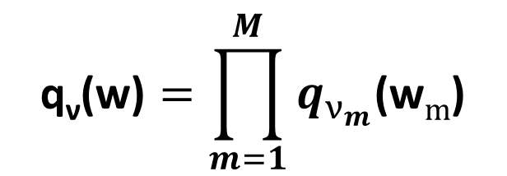

Variational Inference
How to choose the variational distribution q_{ν}(w) such that
the optimization of the bound is computationally tractable?
Typically, we break some dependencies between latent variables
Mean field variational approximations
Assume “fully factorized” variational distributions
$$\text{q}\text{ν}\text{(}\text{w}\text{)}=\prod_{m=1}^{M}{q_{ν_{m}}\text{(}\text{w}m\text{)}}$$
$\text{where} \text{ν}$ = ($\text{ν}\text{1}\text{, }\text{ν}\text{2}\text{,} …,\text{ν}\text{M}\text{)}$

Slide 14


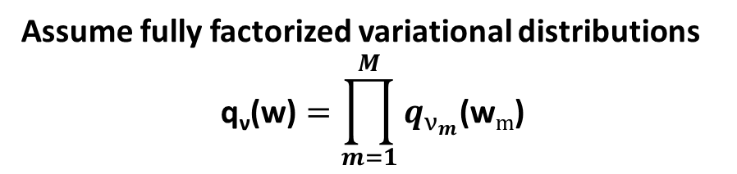
Mean Field Variational Inference
Assume fully factorized variational distributions
$$\text{q}\text{ν}\text{(}\text{w}\text{)}=\prod_{m=1}^{M}{q_{ν_{m}}\text{(}\text{w}m\text{)}}$$

Slide 15
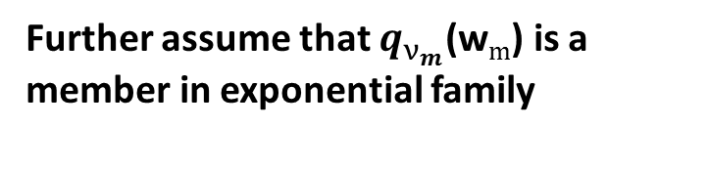
Mean Field Variational Inference in Exponential Families
Further assume that
p(w_{i} | w_{-i}, x, θ)
is a member in exponential family
Further assume that $q_{ν_{m}}\text{(}\text{w}m\text{)}$ is a member in exponential family

Slide 16

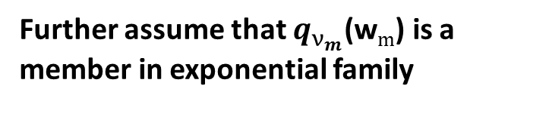
Mean Field Variational Inference in Exponential Families
Further assume that $q_{ν_{m}}\text{(}\text{w}m\text{)}$ is a member in exponential family
Further assume that p(w_{i} | w_{-i}, x, θ)
is a member in exponential family

Slide 17


Mean Field Variational Inference in Exponential Families: Coordinate Ascent
Maximize this with respect to $ν_{m}$ holding other $ν_{i ≠ m}$ fixed
Leads to an EM-like algorithm:
Iteratively update $ν_{i ≠ m}$
This algorithm will find a local maximum of the above expression
Notes:
\nu_i would not be this simple without the assumption that P(w_i | w_{-i}, x, \theta) is a member of exponential family.

Slide 18

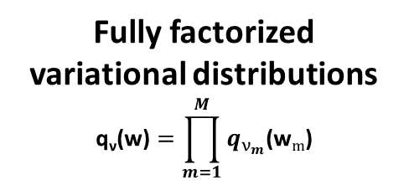
Recap: Mean Field Variational Inference in Exponential Families
p(w_{i} | w_{-i}, x, θ)
is a member in exponential family
Fully factorized
variational distributions
$$\text{q}\text{ν}\text{(}\text{w}\text{)}=\prod_{m=1}^{M}{q_{ν_{m}}\text{(}\text{w}m\text{)}}$$
Some calculus
A local maximum of

Slide 19
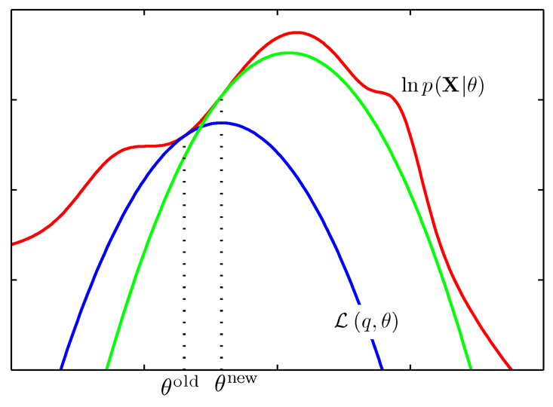
Update Equation and Other Inference Methods
Like Gibbs sampling: iteratively pick a component to update using the exclude-one conditional distribution
Gibbs walks on state that approaches sample from true posterior
VDP walks on distributions that approach a locally best approximation to the true posterior
Like EM: fit a lower bound to the true posterior
EM maximizes, VDP marginalizes
May find local maxima
Figure from Bishop (2006)

Slide 20

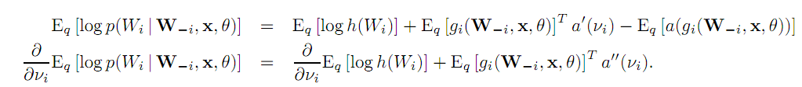
Aside: Derivation of Update Equation
Nothing deep involved...
Expansion of variational lower bound using chain rule for expectations
Set derivative equal to zero and solve
Take advantage of exponential form of exclude-one conditional distribution
Everything cancels...except the update equation

Slide 21
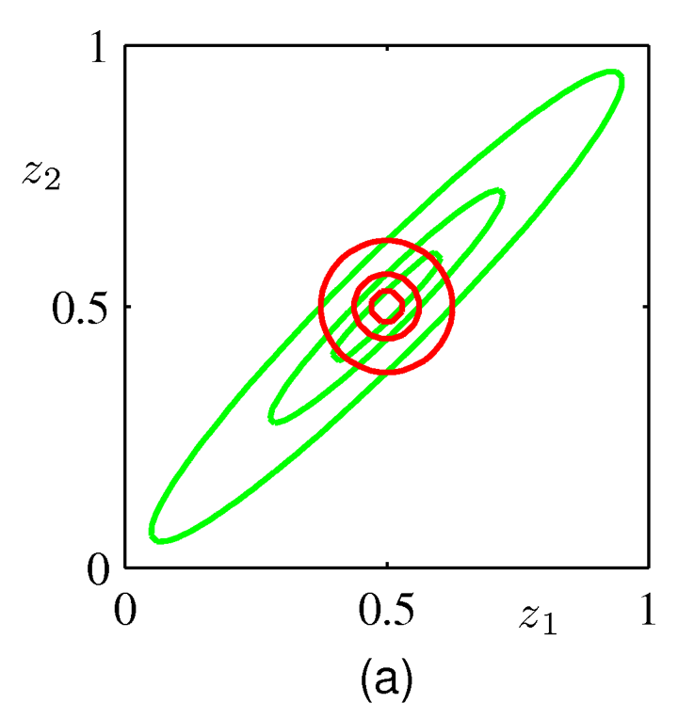
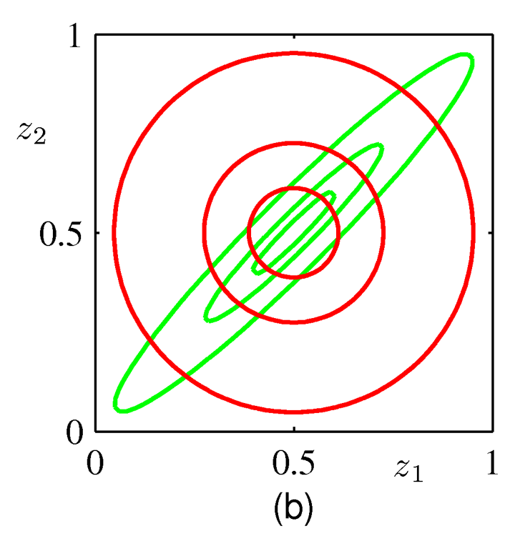
Aside: Which Kullback-Leibler Divergence?
To minimize the reverse KL divergence (when q factorizes), just match the marginals.
Minimizing the reverse KL is the approach taken in expectation propagation.
KL(q||p)
KL(p||q)
Figures from Bishop (2006)

Slide 22
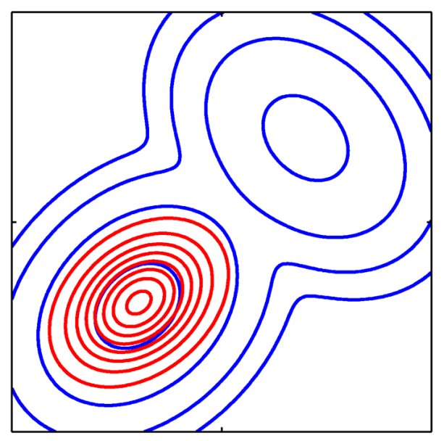
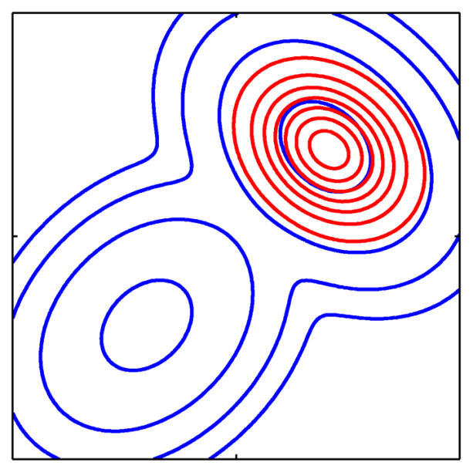
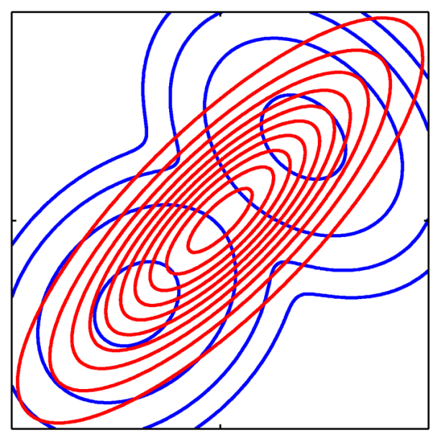
Aside: Which Kullback-Leibler Divergence?
KL(q||p)
KL(p||q)
Figures from Bishop (2006)
Minimizing KL divergence is “zero-forcing”
Minimizing reverse KL divergence is “zero-avoiding”

Slide 23
Applying Mean-Field Variational Inference to DP Mixtures
“Mean field variational inference in exponential families”
But we’re in a mixture model, which can’t be an exponential family!
Enough that the exclude-one conditional distributions are in the exponential family. Examples:
Hidden Markov models
Mixture models
State space models
Hierarchical Bayesian models with (mixture of) conjugate priors

Slide 24
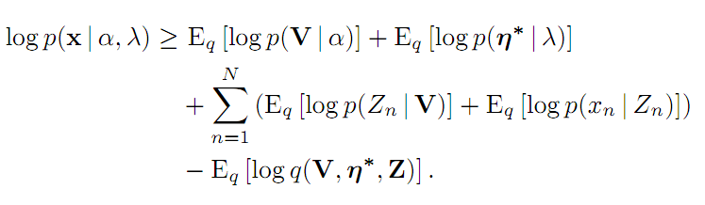
Variational Lower Bound for DP Mixtures
Plug the DP Mixture posterior distribution
Taking log so expectations factor...
Shouldn’t the emission term depend on η*?
Last term has implications for choice of variational distribution

Slide 25
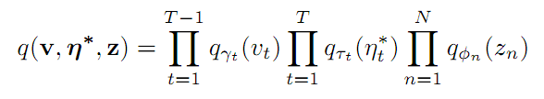

Picking the Variational Distribution
Obviously, we want to break dependencies
Must the factors be exponential families?
In some cases, the optimum must be!
Proof using calculus of variations
Easier to compute integrals for lower bound
Guarantee of optimal parameters
Mapping between canonical and moment parameters
Beta, exponential family, and multinomial distributions, respectively

Slide 26
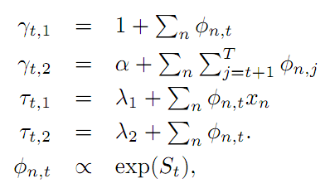
Coordinate Ascent
Analogy to EM: we might get stuck in local maxima

Slide 27
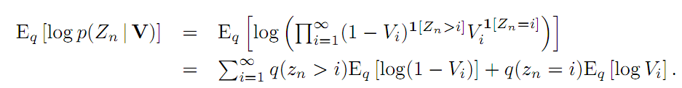
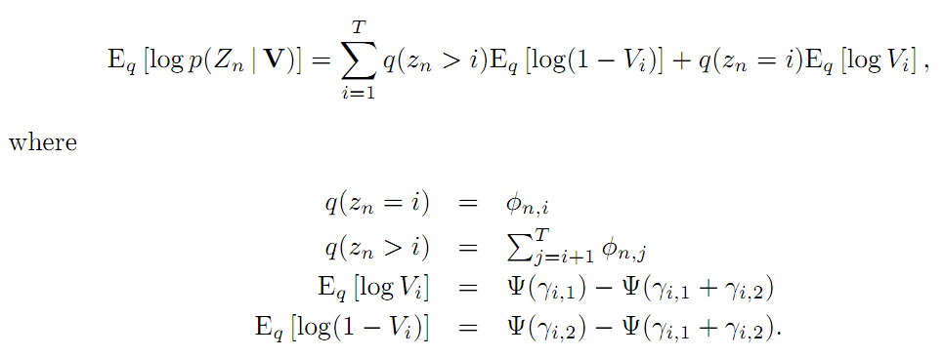
Coordinate Ascent: Derivation
Relies on clever use of indicator functions and their properties
All the terms in the truncation have closed-form expressions

Slide 28
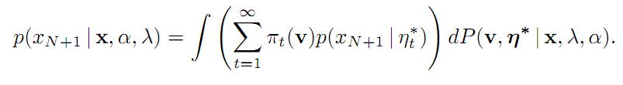
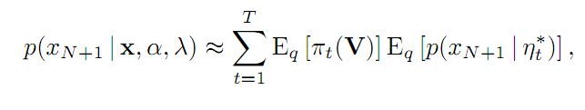
Predictive Distribution
Under variational approximation, distribution of atoms and the (truncated) distribution of stick lengths decouple
Weighted sum of predictive distributions
Suggestive of a MC approximation

Slide 29
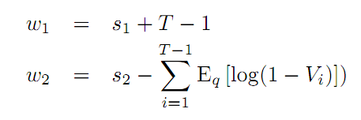
Extensions
Prior as mixture of conjugate distributions
Placing a prior on the scaling parameter α
Continue complete factorization...
Natural to place Gamma prior on α
Update equation no more difficult than the others
No modification needed to predictive distribution!

Slide 30

Empirical Comparison: The Competition
Collapsed Gibbs sampler (MacEachern 1994)
“CDP”
Predictive distribution as average of predictive distributions from MC samples
Best suited for conjugate priors
Blocked Gibbs sampler (Ishwaran and James 2001)
“TDP”
Recall: posterior distribution gets truncated
Surface similarities to VDP in updates for Z, V, η*
Predictive distribution integrates out everything but Z
Surprise:
TDP
CDP
Autocorrelation on size of largest component

Slide 31
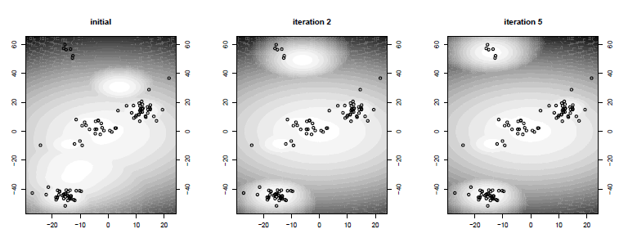
Empirical Comparison
Notes:
The data are 100 points generated by a Gaussian DP mixture model with fixed diagonal covariance.
The approximate predictive distribution given by variational inference

Slide 32
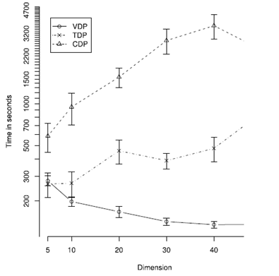
Empirical Comparison
Notes:
Average convergence time across ten datasets per dimension
Variational inference
Was Faster
Exhibited significantly less variance in its convergence time
When dimension increases, convergence time does not seem to grow with it

Slide 33
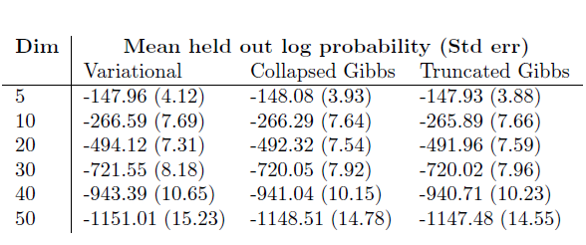
Empirical Comparison
Notes:
The result is pretty accurate for this class of DP mixture

Slide 34
Empirical Comparison: Summary
Deterministic
Fast
Easy to assess convergence
Sensitive to initializations = Local Maximum
Approximate

Slide 35

Image Analysis

Slide 36
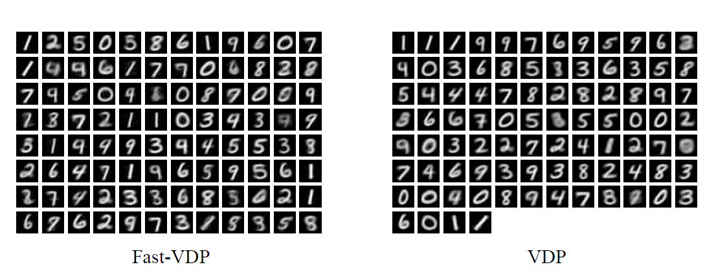
MNIST: Hand-written digits
Kurihara, Welling, and Vlassis 2006

Slide 37
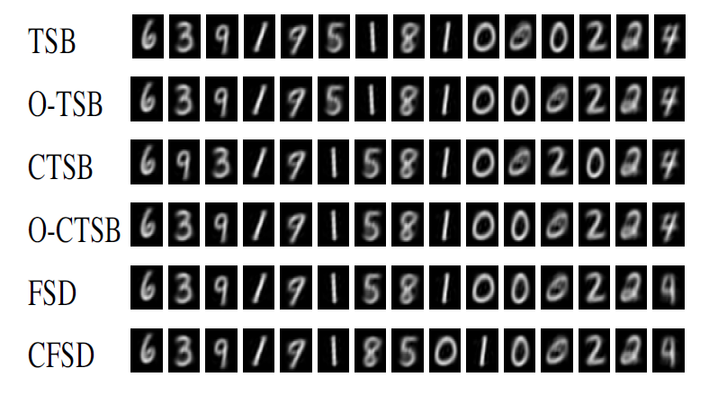
MNIST: Hand-written digits
“Variational approximations are much more efficient computationally than Gibbs sampling,
with almost no loss in accuracy”
Kurihara, Welling, and Teh 2007

Slide 38
Questions?

Slide 39
Acknowledgement
http://www.cs.princeton.edu/courses/archive/fall07/cos597C/scribe/20071022a.pdf
http://www.cs.princeton.edu/courses/archive/fall07/cos597C/scribe/20071022b.pdf

